Slide 1
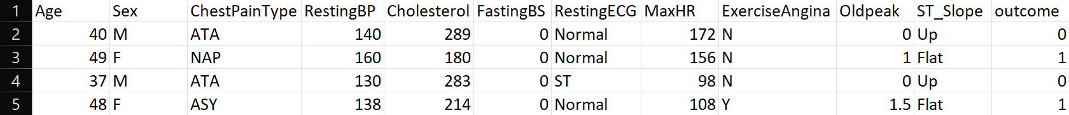
Data Collection
Source : The dataset was sourced from Kaggle, a popular platform for machine learning datasets and competitions.
Description: This dataset includes various features related to heart disease diagnosis, such as age, cholesterol levels, and exercise habits.
Link: [Heart Disease UCI Dataset on Kaggle] (https://www.kaggle.com/datasets)

Slide 2
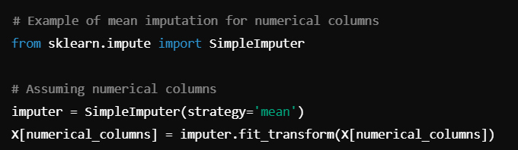
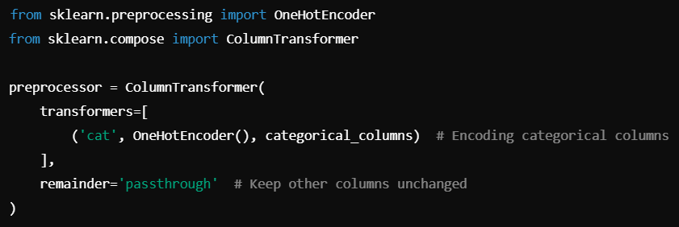
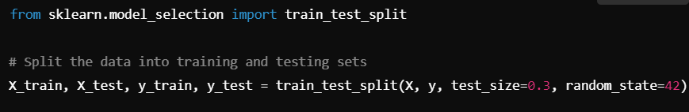
Data Preprocessing
Steps Involved:
- Handling missing values.
- Encoding categorical data
(gender)
- Splitting into training
and testing datasets
- Libraries Used: Pandas,
Scikit-learn, NumPy, Matplotlib

Slide 3
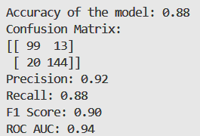
Machine Learning Model Overview
• Model Selection: Random Forest model uses decision trees and bagging to analyze data. It can handle large data sets and thousands of input variables . It has a higher true positive rate than logistic regression, but also has a higher false positive rate for datasets with more noise variables. | • Training Process: Train model on health indicators to predict heart disease risk
• Correlation Analysis: Features influencing the model's predictions significantly. | • Evaluation Metrics: Accuracy, Precision, Recall, F1-score

